Slide 1
CSET301 – AI-ML
Lecture 25 : DBSCAN

Slide 2
Clustering Algorithms
Clustering algorithms can be generally classified into four categories:
Partitioning based: K-means
Hierarchy based: AGNES, DIANA
Density based: DBSCAN
Grid based: CLIQUE

Slide 3
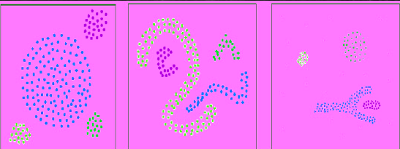

Density based clustering algorithms
Density based clustering algorithms assume that clusters are dense regions in space separated by regions of lower density.
A dense cluster is a region which is “density connected”, i.e. the density of points in that region is greater than a minimum.
Since these algorithms expand clusters based on dense connectivity, they can find clusters of arbitrary shapes.
DBSCAN is an example of density-based clustering algorithm.

Slide 4

DBSCAN (Density Based Spatial Clustering of Applications with Noise)
Published by Ester et al. in 1996
The algorithm finds dense areas and expands these recursively to find dense arbitrarily shaped clusters.
Since it has a concept of noise, it works well even with noisy datasets.

Slide 5
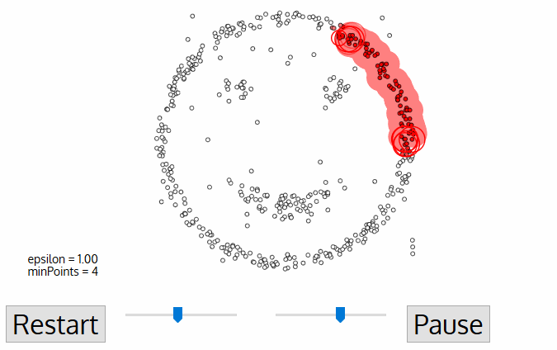
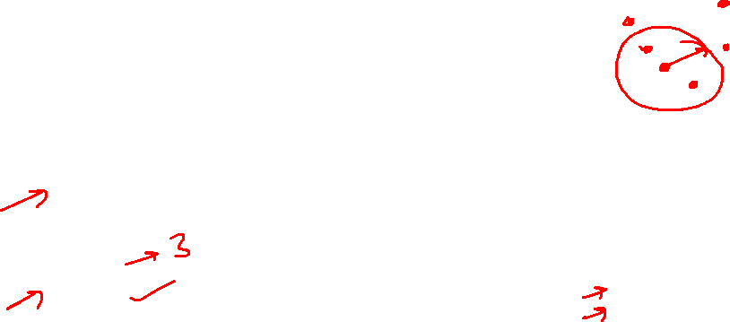
DBSCAN (Density Based Spatial Clustering of Applications with Noise)
Two main parameters to DBSCAN to define density are:
Eps (ε): defines radius of the ‘neighborhood region’
minPoints: defines the minimum number of points (a threshold) that should be contained within that neighborhood (to be considered as dense).

Slide 6
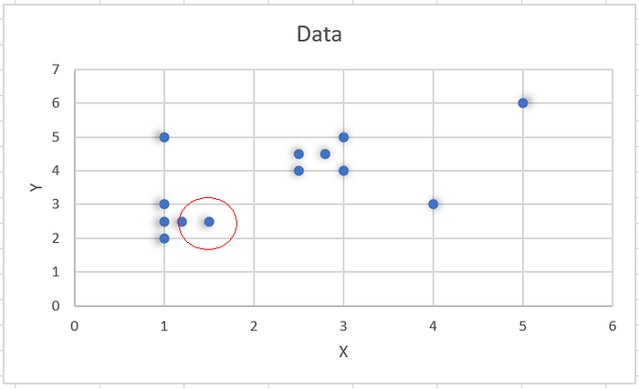

DBSCAN (Density Based Spatial Clustering of Applications with Noise)
The DBSCAN algorithm takes two input parameters: eps and minpts.
Considering the example, consider the point (1.5,2.5), if we take eps = 0.3, then the circle around the point with radius = 0.3, will contain only one other point inside it (1.2,2.5) as shown here

Slide 7
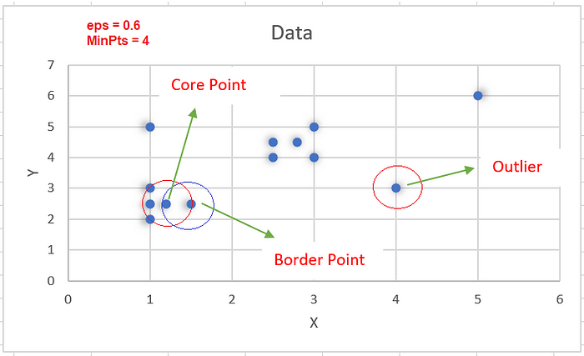

DBSCAN (Density Based Spatial Clustering of Applications with Noise)
In this, we have 3 types of data points:
Core Point: A point is a core point if it has more than MinPts points within eps.
Border Point: A point which has fewer than MinPts within “eps” but it is in the neighborhood of a core point.
Noise or outlier: A point which is not a core point or border point.

Slide 8
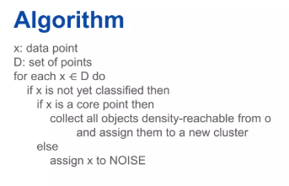

DBSCAN Algo
The algorithm proceeds by arbitrarily picking up point in the dataset (until all points have been visited).
▪ If there are at least ‘minPoint’ points within a radius of ‘ε’ to the point then we consider all these points to be part of the same cluster.
▪ The clusters are then expanded by recursively repeating the neighborhood calculation for each neighboring point.
▪ The complexity of this algorithm is O(n2), where n is the number of points.

Slide 9
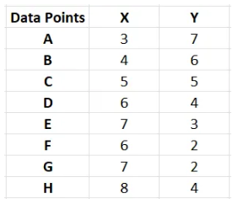

DBSCAN Numerical
Q. Given the points A(3, 7), B(4, 6), C(5, 5), D(6, 4), E(7, 3), F(6, 2), G(7, 2) and H(8, 4), Find the core points and outliers using DBSCAN. Take Eps = 2.5 and MinPts = 3.

Slide 10
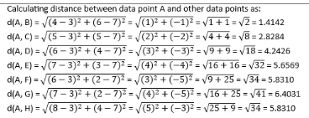

DBSCAN Numerical
Step 1: To find the core points, outliers and clusters by using DBSCAN we need to first calculate the distance among all pairs of given data point. Let us use Euclidean distance measure for distance calculation.

Slide 11
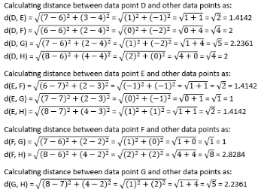
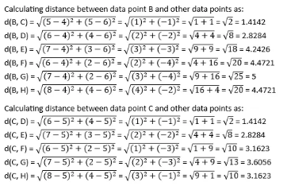

DBSCAN Numerical

Slide 12
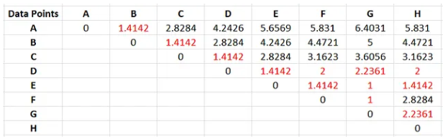
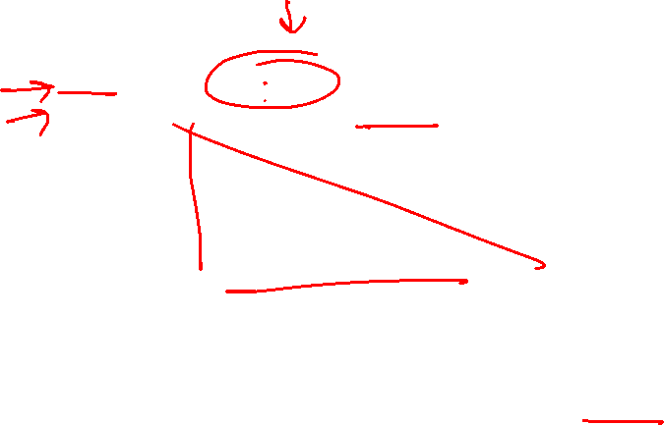
DBSCAN Numerical
The final distance matrix becomes as shown below:
In the above table, Distance ≤ Epsilon (i.e. 2.5) is marked red.

Slide 13

DBSCAN Numerical
Step 2: Now, finding all the data points that lie in the Eps-neighborhood of each data points. That is, put all the points in the neighborhood set of each data point whose distance is <=2.5.
N(A) = {B}; — — — — — — -→ because distance of B is <= 2.5 with A
N(B) = {A, C}; — — — — — → because distance of A and C is <= 2.5 with B
N(C) = {B, D}; — — — — —→ because distance of B and D is <=2.5 with C
N(D) = {C, E, F, G, H}; — → because distance of C, E, F,G and H is <=2.5 with D
N(E) = {D, F, G, H}; — — → because distance of D, F, G and H is <=2.5 with E
N(F) = {D, E, G}; — — — — → because distance of D, E and G is <=2.5 with F
N(G) = {D, E, F, H}; — — -→ because distance of D, E, F and H is <=2.5 with G
N(H) = {D, E, G}; — — — — → because distance of D, E and G is <=2.5 with H

Slide 14

DBSCAN Numerical
N(A) = {B};
N(B) = {A, C};
N(C) = {B, D};
N(D) = {C, E, F, G, H};
N(E) = {D, F, G, H};
N(F) = {D, E, G};
N(G) = {D, E, F, H};
N(H) = {D, E, G};
Here, data points A, B and C have neighbors <= MinPts (i.e. 3) so can’t be considered as core points. Since they belong to the neighborhood of other data points, hence there exist no outliers in the given set of data points.
Data points D, E, F, G and H have neighbors >= MinPts (i.e. 3) and hence are the core data points.

Slide 15

DBSCAN: Evaluation metrics
Silhouette's score is in the range of -1 to 1. A score near 1 denotes the data point is very compact within the cluster to which it belongs and far away from the other clusters. The worst value is -1. Values near 0 denote overlapping clusters.
Absolute Rand Score is in the range of 0 to 1. More than 0.9 denotes excellent cluster recovery and above 0.8 is a good recovery. Less than 0.5 is considered to be poor recovery.

Slide 16
DBSCAN: Key points
If eps is too small most points will be classified as noise.
If eps is too large clusters may merge and the algorithm may fail to distinguish between them.

Slide 17

DBSCAN vs K-means
DBSCAN | K-Means
In DBSCAN we need not specify the number of clusters. | It is very sensitive to the number of clusters so it need to specified
Clusters formed in DBSCAN can be of any arbitrary shape. | Clusters formed are spherical or convex in shape
It can work well with datasets having noise and outliers | It does not work well with outliers data. Outliers can skew the clusters in K-Means to a very large extent.
In DBSCAN two parameters are required for training the Model | In K-Means only one parameter is required is for training the model

Slide 18
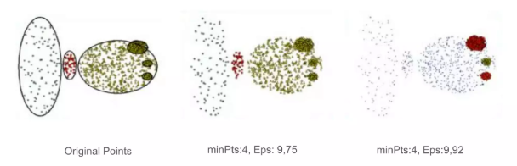

DBSCAN
Advantages: Can handle clusters of different shapes and sizes
Resistant to noise
Disadvantages: Sensitive in parameter selection.

Slide 19
References
https://medium.com/@karna.sujan52/density-based-dbscan-numerical-f4e00b9cce68

Slide 20
Thank You

